Slide 1
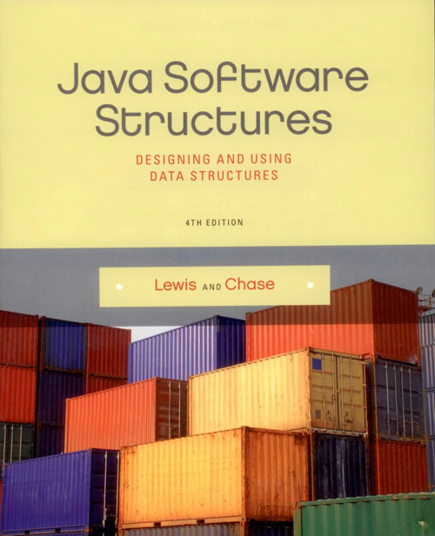
Chapter 2
Analysis of Algorithms

Slide 2
Chapter Scope
Efficiency goals
The concept of algorithm analysis
Big-Oh notation
The concept of asymptotic complexity
Comparing various growth functions

Slide 3
Algorithm Efficiency
The efficiency of an algorithm is usually expressed in terms of its use of CPU time
The analysis of algorithms involves categorizing an algorithm in terms of efficiency
An everyday example: washing dishes
Suppose washing a dish takes 30 seconds and drying a dish takes an additional 30 seconds
Therefore, n dishes require n minutes to wash and dry

Slide 4
Algorithm Efficiency
Now consider a less efficient approach that requires us to redry all previously washed dishes after washing another one

Slide 5
Problem Size
For every algorithm we want to analyze, we need to define the size of the problem
The dishwashing problem has a size n – number of dishes to be washed/dried
For a search algorithm, the size of the problem is the size of the search pool
For a sorting algorithm, the size of the program is the number of elements to be sorted

Slide 6
Growth Functions
We must also decide what we are trying to efficiently optimize
time complexity – CPU time
space complexity – memory space
CPU time is generally the focus
A growth function shows the relationship between the size of the problem (n) and the value optimized (time)

Slide 7
Asymptotic Complexity
The growth function of the second dishwashing algorithm is
t(n) = 15n² + 45n
It is not typically necessary to know the exact growth function for an algorithm
We are mainly interested in the asymptotic complexity of an algorithm – the general nature of the algorithm as n increases

Slide 8
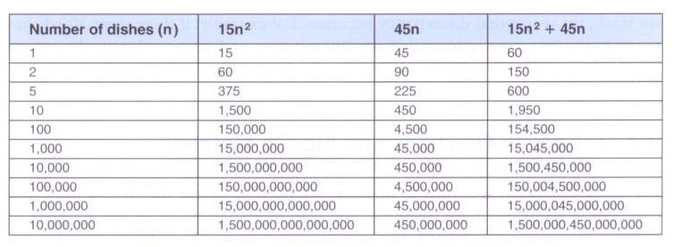
Asymptotic Complexity
Asymptotic complexity is based on the dominant term of the growth function – the term that increases most quickly as n increases
The dominant term for the second dishwashing algorithm is n²:

Slide 9
Big-Oh Notation
The coefficients and the lower order terms become increasingly less relevant as n increases
So we say that the algorithm is order n², which is written O(n²)
This is called Big-Oh notation
There are various Big-Oh categories
Two algorithms in the same category are generally considered to have the same efficiency, but that doesn't mean they have equal growth functions or behave exactly the same for all values of n

Slide 10
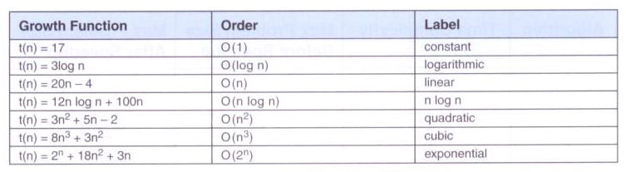
Big-Oh Categories
Some sample growth functions and their Big-Oh categories:

Slide 11
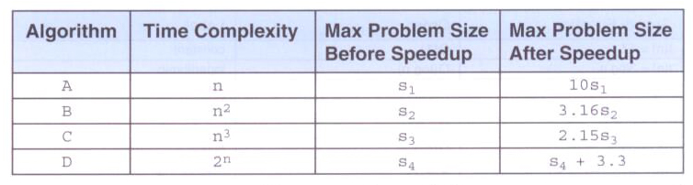
Comparing Growth Functions
You might think that faster processors would make efficient algorithms less important
A faster CPU helps, but not relative to the dominant term

Slide 12
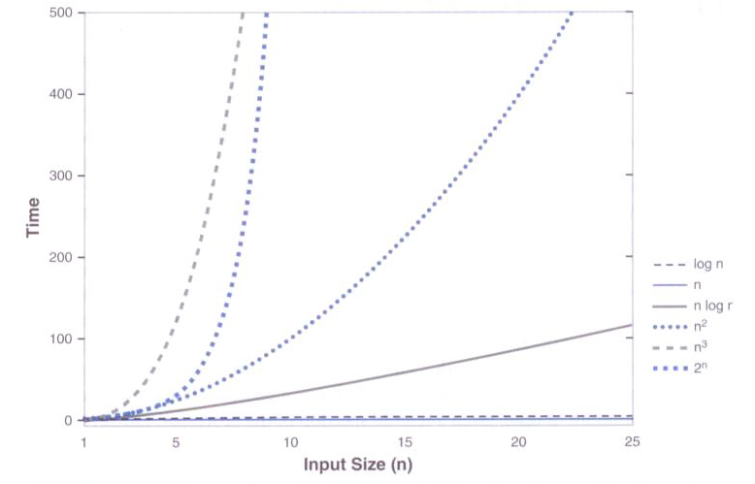
Comparing Growth Functions
As n increases, the various growth functions diverge dramatically:

Slide 13
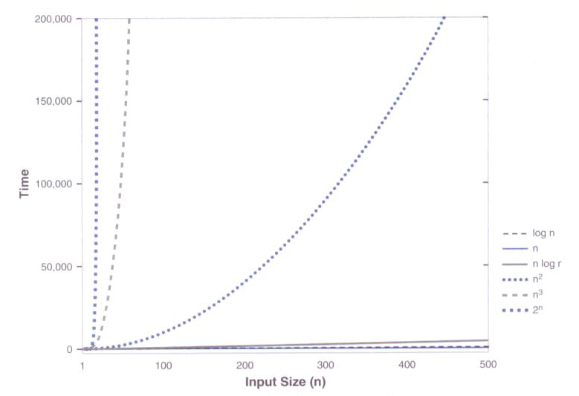
Comparing Growth Functions
For large values of n, the difference is even more pronounced:

Slide 14
Analyzing Loop Execution
First determine the order of the body of the loop, then multiply that by the number of times the loop will execute
for (int count = 0; count < n; count++)
// some sequence of O(1) steps
N loop executions times O(1) operations results in a O(n) efficiency

Slide 15
Analyzing Loop Execution
Consider the following loop:
count = 1;
while (count < n)
{
count *= 2;
// some sequence of O(1) steps
}
The loop is executed log₂n times, so the loop is O(log n)

Slide 16
Analyzing Nested Loops
When loops are nested, we multiply the complexity of the outer loop by the complexity of the inner loop
for (int count = 0; count < n; count++)
for (int count2 = 0; count2 < n; count2++)
{
// some sequence of O(1) steps
}
Both the inner and outer loops have complexity of O(n)
The overall efficiency is O(n²)

Slide 17
Analyzing Method Calls
The body of a loop may contain a call to a method
To determine the order of the loop body, the order of the method must be taken into account
The overhead of the method call itself is generally ignored

